Slide 1
Supervised Learning
Debajyoti Biswas

Slide 2
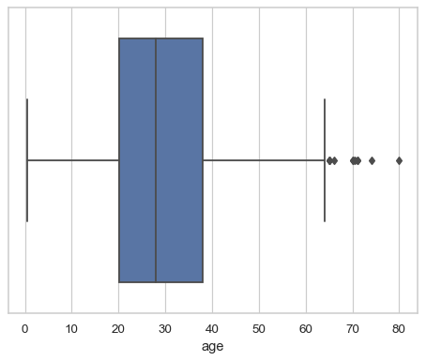
Box Plot
A box plot (or box-and-whisker plot)-
shows the distribution of quantitative data in a way that facilitates comparisons between variables or across levels of a categorical variable.
The box shows the quartiles of the dataset
while the whiskers extend to show the rest of the distribution,
except for points that are determined to be “outliers”
seaborn.boxplot — seaborn 0.12.2 documentation (pydata.org)

Slide 3
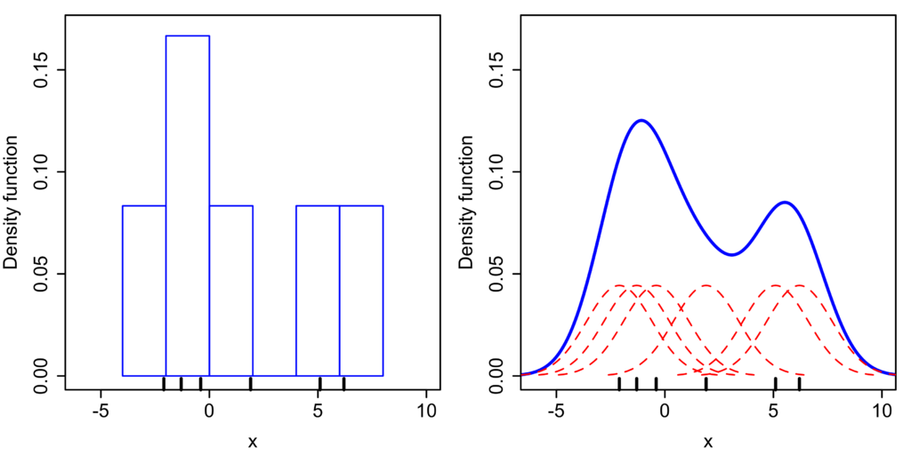
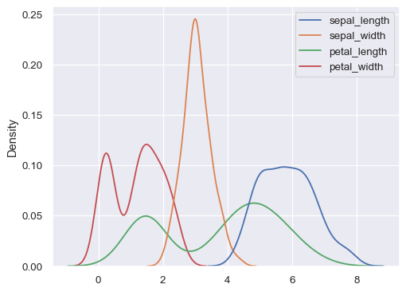
KDE Plot
Plot univariate or bivariate distributions using kernel density estimation.
A kernel density estimate (KDE) plot is a method for visualizing the distribution of observations in a dataset, analogous to a histogram.
KDE represents the data using a continuous probability density curve in one or more dimensions.
Comparison of the histogram (left) and kernel density estimate (right) constructed using the same data. The six individual kernels are the red dashed curves, the kernel density estimate the blue curves.
seaborn.kdeplot — seaborn 0.12.2 documentation (pydata.org)

Slide 4

KDE Plot (Kernel Density Estimate)
Let (x₁, x₂, ..., x_{n}) be independent and identically distributed samples drawn from some univariate distribution with an unknown density ƒ at any given point x. We are interested in estimating the shape of this function ƒ. Its kernel density estimator is
where K is the kernel — a non-negative function — and h > 0 is a smoothing parameter called the bandwidth.

Slide 5
Violin Plot
Draw a combination of boxplot and kernel density estimate.
A violin plot plays a similar role as a box and whisker plot. It shows the distribution of quantitative data across several levels of one (or more) categorical variables such that those distributions can be compared.
Unlike a box plot, in which all of the plot components correspond to actual datapoints, the violin plot features a kernel density estimation of the underlying distribution.
This can be an effective and attractive way to show multiple distributions of data at once

Slide 6
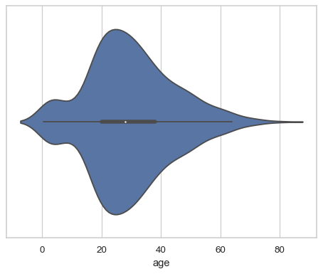
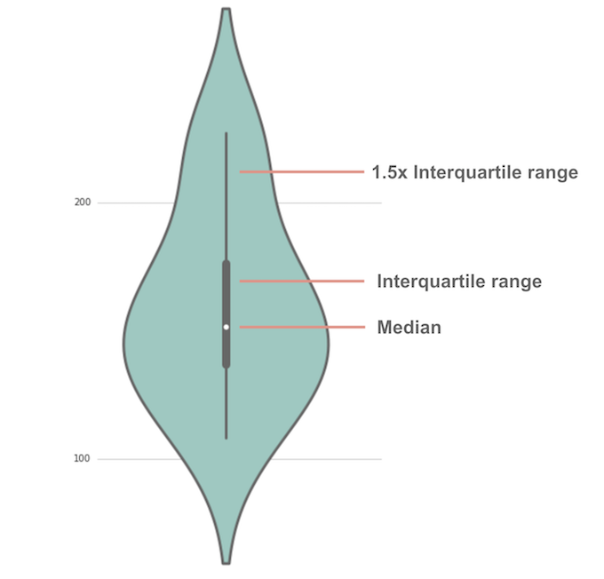
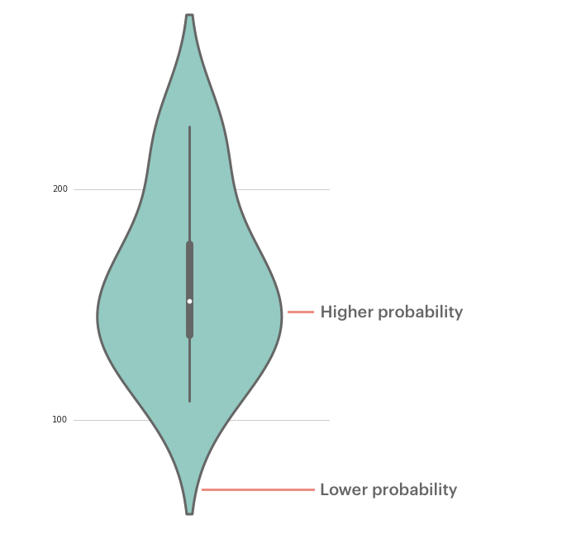
Violin Plot
Draw a combination of boxplot and kernel density estimate.
seaborn.violinplot — seaborn 0.12.2 documentation (pydata.org)

Slide 7
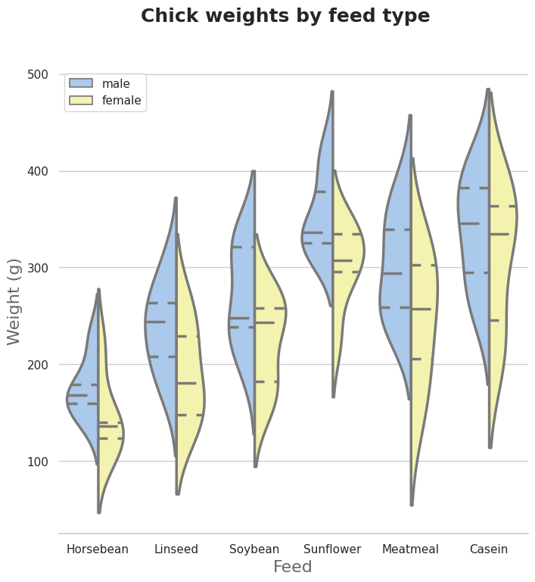
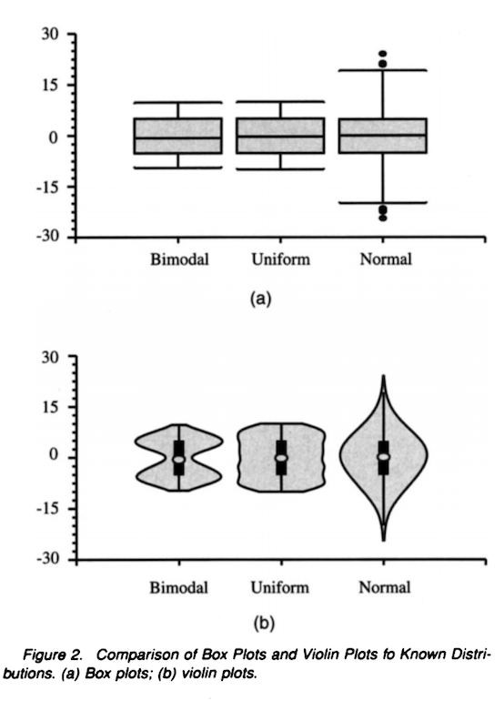
Box plot and Violin Plot

Slide 8
Machine Learning
Machine learning (ML) is a field of inquiry devoted to understanding and building methods that "learn" – that is, mathematical methods that leverage data to improve performance on some set of tasks. It is seen as a part of artificial intelligence.
"A computer program is said to learn from experience E with respect to some class of tasks T and performance measure P if its performance at tasks in T, as measured by P, improves with experience E.“- Tom Mitchel

Slide 9
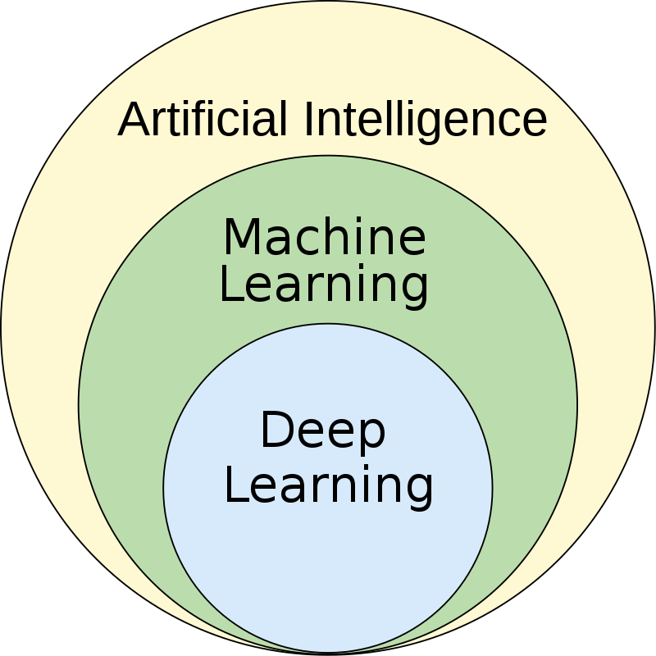
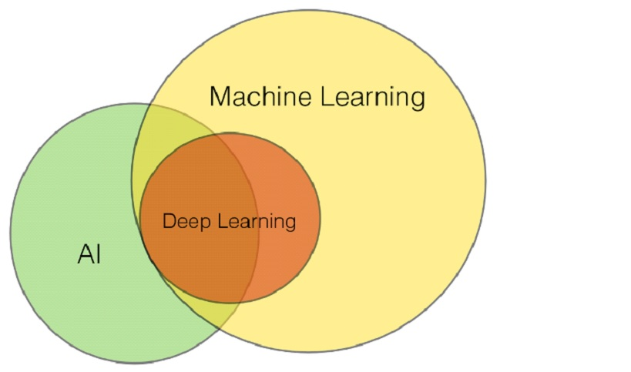
Unit 5: Machine Learning

Slide 10
Machine learning approaches are traditionally divided into three broad categories, which correspond to learning paradigms, depending on the nature of the "signal" or "feedback" available to the learning system:
Supervised learning: The computer is presented with example inputs and their desired outputs, given by a "teacher", and the goal is to learn a general rule that maps inputs to outputs.

Slide 11
Machine learning approaches are traditionally divided into three broad categories, which correspond to learning paradigms, depending on the nature of the "signal" or "feedback" available to the learning system:
Supervised learning: The computer is presented with example inputs and their desired outputs, given by a "teacher", and the goal is to learn a general rule that maps inputs to outputs.
Unsupervised learning: No labels are given to the learning algorithm, leaving it on its own to find structure in its input. Unsupervised learning can be a goal in itself (discovering hidden patterns in data) or a means towards an end (feature learning).

Slide 12
Machine learning approaches are traditionally divided into three broad categories, which correspond to learning paradigms, depending on the nature of the "signal" or "feedback" available to the learning system:
Supervised learning: The computer is presented with example inputs and their desired outputs, given by a "teacher", and the goal is to learn a general rule that maps inputs to outputs.
Unsupervised learning: No labels are given to the learning algorithm, leaving it on its own to find structure in its input. Unsupervised learning can be a goal in itself (discovering hidden patterns in data) or a means towards an end (feature learning).
Reinforcement learning: A computer program interacts with a dynamic environment in which it must perform a certain goal (such as driving a vehicle or playing a game against an opponent). As it navigates its problem space, the program is provided feedback that's analogous to rewards, which it tries to maximize.

Slide 13
Examples of Supervised Learning algorithms :
Support-vector machines
Linear regression
Logistic regression
Naive Bayes
Linear discriminant analysis
Decision trees
K-nearest neighbor algorithm
Neural networks (Multilayer perceptron)

Slide 14
Examples of Supervised Learning algorithms :
Support-vector machines
Linear regression
Logistic regression
Naive Bayes
Linear discriminant analysis
Decision trees
K-nearest neighbor algorithm
Neural networks (Multilayer perceptron)

Slide 15
Some of the most common algorithms used in unsupervised learning include:
(1) Clustering- hierarchical clustering, k-means clustering
(2) Principal component analysis, Singular value decomposition

Slide 16
NPTEL-Intro-to-ML/2a-linear-regression-18May.pptx at master · raviudal/NPTEL-Intro-to-ML (github.com)
Andrew Ng in Coursera- software: MATLAB
Prof Sudeshna Sarkar from IIT Kgp- NPTEL Intro to ML (uses Python)- if you do not like heavy mathematics
If you like mathematics Prof Balaraman Ravindran from IIT M NPTEL course

Slide 17
Supervised Learning
Supervised learning (SL) is
A machine learning paradigm for problems where the available data consists of labeled examples
Each data point contains features (covariates) and an associated label.
The goal of supervised learning algorithms is learning a function that maps feature vectors (inputs) to labels (output), based on example input-output pairs.
A supervised learning algorithm analyzes the training data and produces an inferred function, which can be used for mapping new examples.

Slide 18
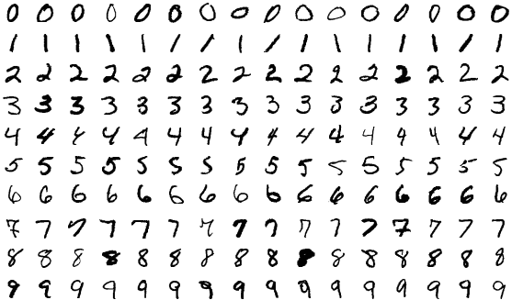
Supervised Learning : Steps To Follow
Determine the type of training examples.
Before doing anything else, the user should decide what kind of data is to be used as a training set.
In the case of handwriting analysis, for example, this might be a single handwritten character, an entire handwritten word, an entire sentence of handwriting or perhaps a full paragraph of handwriting.
Sample images from MNIST test dataset

Slide 19
Supervised Learning : Steps To Follow
Determine the type of training examples.
Gather a training set.
The training set needs to be representative of the real-world use of the function.
Thus, a set of input objects is gathered and corresponding outputs are also gathered, either from human experts or from measurements.

Slide 20
Supervised Learning : Steps To Follow
Determine the type of training examples.
Gather a training set.
Determine the accuracy of the input feature representation of the learned function.
The accuracy of the learned function depends strongly on how the input object is represented.

Slide 21
Supervised Learning : Steps To Follow
Determine the type of training examples.
Gather a training set.
Determine the accuracy of the input feature representation of the learned function.
Determine the structure of the learned function and corresponding learning algorithm.
Complete the design and evaluate the accuracy of the learned function

Slide 22
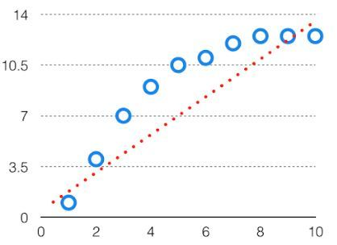
Bias
The bias is known as the difference between the prediction of the values by the Machine Learning model and the correct value.
Being high in biasing gives a large error in training as well as testing data. It recommended that an algorithm should always be low-biased to avoid the problem of underfitting.
By high bias, the data predicted is in a straight line format, thus not fitting accurately in the data in the data set.
Such fitting is known as the Underfitting of Data. This happens when the hypothesis is too simple or linear in nature.
In such a problem, a hypothesis looks like -
Bias-Variance Trade Off - Machine Learning - GeeksforGeeks

Slide 23
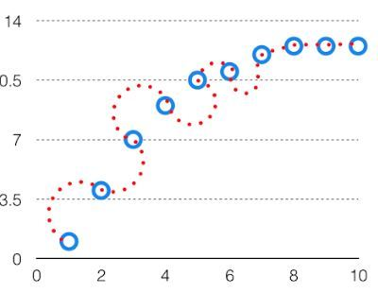
Variance
The variability of model prediction for a given data point which tells us the spread of our data is called the variance of the model.
The model with high variance has a very complex fit to the training data and thus is not able to fit accurately on the data which it hasn’t seen before. As a result, such models perform very well on training data but have high error rates on test data.
When a model is high on variance, it is then said to as Overfitting of Data. Overfitting is fitting the training set accurately via complex curve and high order hypothesis but is not the solution as the error with unseen data is high.
While training a data model variance should be kept low. The high variance data looks as shown in the image
In such a problem, a hypothesis looks like follows

Slide 24
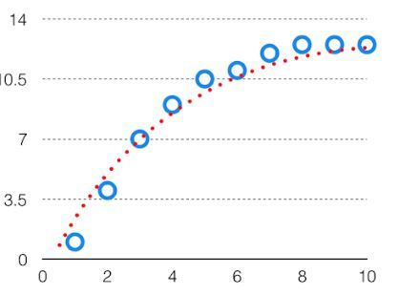
Bias Variance Tradeoff
If the algorithm is too simple (hypothesis with linear equation) then it may be on high bias and low variance condition and thus is error-prone.
If algorithms fit too complex (hypothesis with high degree equation) then it may be on high variance and low bias.
In the latter condition, the new entries will not perform well.
Well, there is something between both of these conditions, known as a Trade-off or Bias Variance Trade-off. An algorithm can’t be more complex and less complex at the same time. For the graph, the perfect tradeoff will be like this.

Slide 25
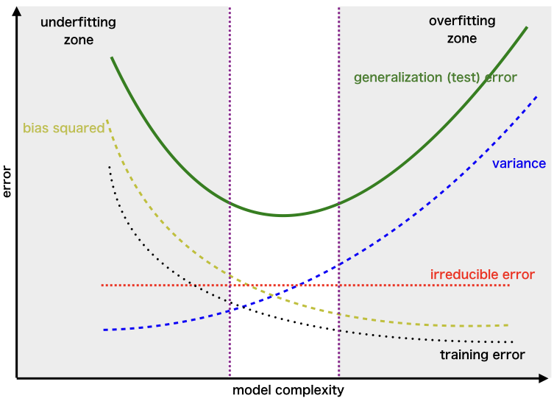
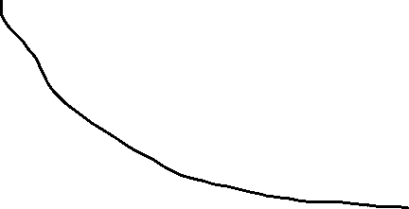
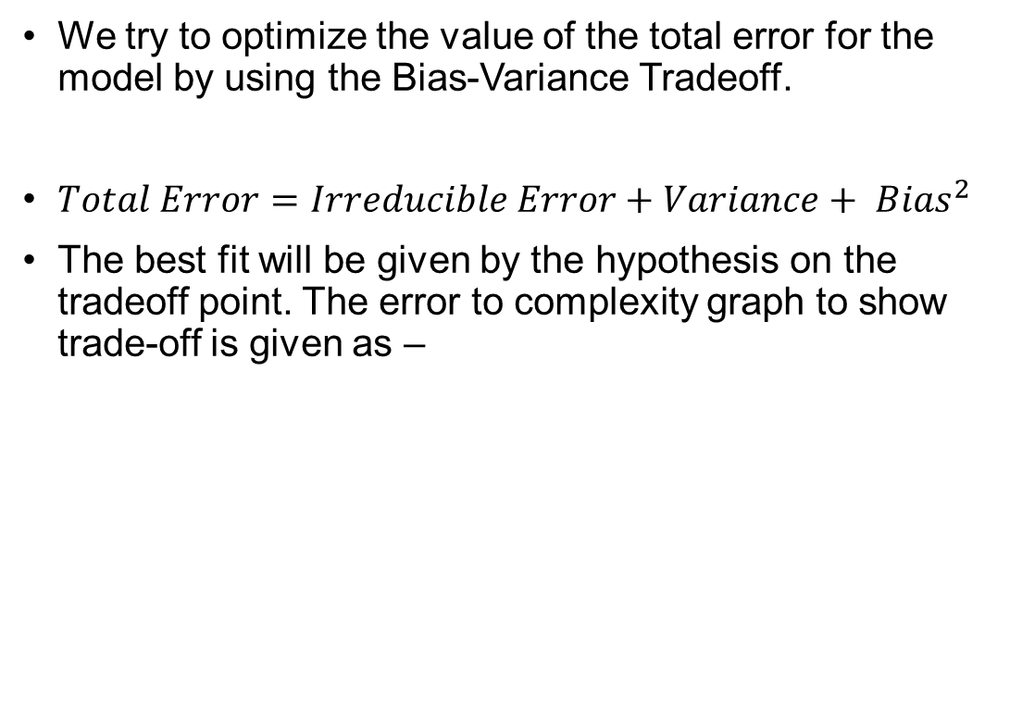
Bias Variance Tradeoff
We try to optimize the value of the total error for the model by using the Bias-Variance Tradeoff.
$Total Error=Irreducible Error+Variance+ {Bias}^{2}$
The best fit will be given by the hypothesis on the tradeoff point. The error to complexity graph to show trade-off is given as –
Region for the Least Value of Total Error
This is referred to as the best point chosen for the training of the algorithm which gives low error in training as well as testing data.

Slide 26
Supervised Learning : Major Issues
Issue 1: Bias Variance Tradeoff
The bias error is an error from erroneous assumptions in the learning algorithm. High bias can cause an algorithm to miss the relevant relations between features and target outputs (underfitting).
The variance is an error from sensitivity to small fluctuations in the training set. High variance may result from an algorithm modeling the random noise in the training data (overfitting).
As we increase the number of tunable parameters in a model, it becomes more flexible, and can better fit a training data set. It is said to have lower error, or bias.
However, for more flexible models, there will tend to be greater variance to the model fit each time we take a set of samples to create a new training data set. It is said that there is greater variance in the model's estimated parameters.

Slide 27
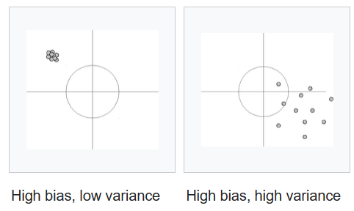
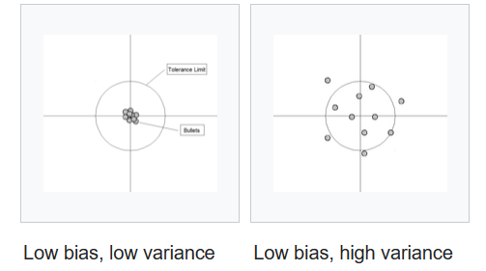

Slide 28
Supervised Learning : Major Issues
Generally, there is a tradeoff between bias and variance.
A learning algorithm with low bias must be "flexible" so that it can fit the data well. But if the learning algorithm is too flexible, it will fit each training data set differently, and hence have high variance.
A key aspect of many supervised learning methods is that they are able to adjust this tradeoff between bias and variance (either automatically or by providing a bias/variance parameter that the user can adjust).

Slide 29
Supervised Learning : Major Issues
Issue 2: Function complexity and amount of training data
The amount of training data available relative to the complexity of the "true" function.
If the true function is simple, then an "inflexible" learning algorithm with high bias and low variance will be able to learn it from a small amount of data.
if the true function is highly complex, then the function will only be able to learn with a large amount of training data paired with a "flexible" learning algorithm with low bias and high variance.

Slide 30
Supervised Learning : Major Issues
Issue 3: Dimensionality of the input space
If the input feature vectors have large dimensions, learning the function can be difficult even if the true function only depends on a small number of those features.
The many "extra" dimensions can confuse the learning algorithm and cause it to have high variance.
Engineer can manually remove irrelevant features from the input data, it will likely improve the accuracy of the learned function. In addition, there are many algorithms for feature selection

Slide 31
Supervised Learning : Major Issues
Issue 4: The degree of noise in the desired output values
If the desired output values are often incorrect (because of human error or sensor errors), then the learning algorithm should not attempt to find a function that exactly matches the training examples. Attempting to fit the data too carefully leads to overfitting.

Slide 32
Supervised Learning : Algorithms
The most widely used learning algorithms are:
Linear regression
Logistic regression
Naive Bayes
Linear discriminant analysis
Decision trees
K-nearest neighbor algorithm
Neural networks (Multilayer perceptron)
Support-vector machines

Slide 33
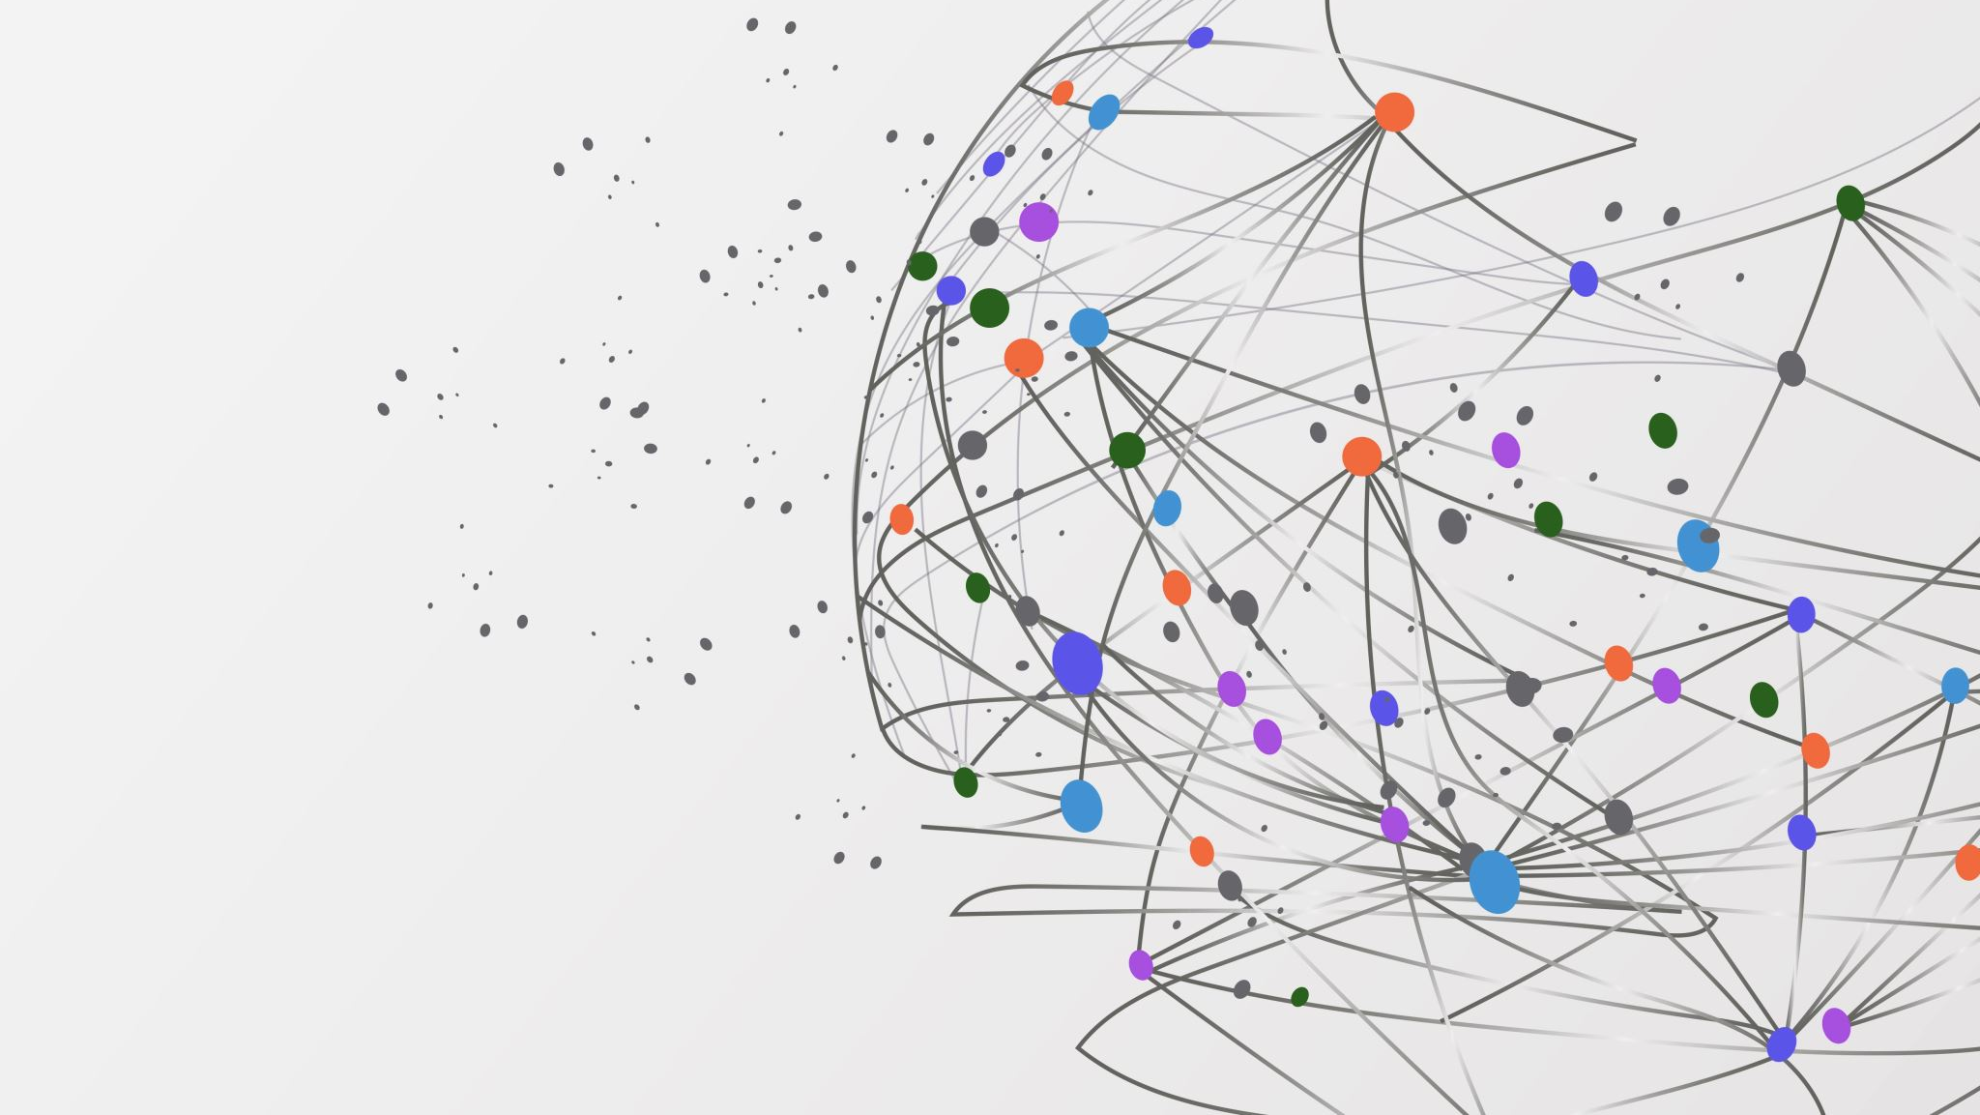
Linear regression

Slide 34
Simple Linear Regression (SLR)
For a given dataset of n statistical units
a linear regression model assumes that the relationship between the dependent variable y and the vector of regressors x is linear.
So the model is
where ^{T} denotes the transpose

Slide 35

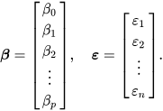
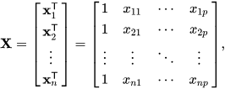
Linear Regression(LR)
Often these n equations are stacked together and written in matrix notation as where

Slide 36
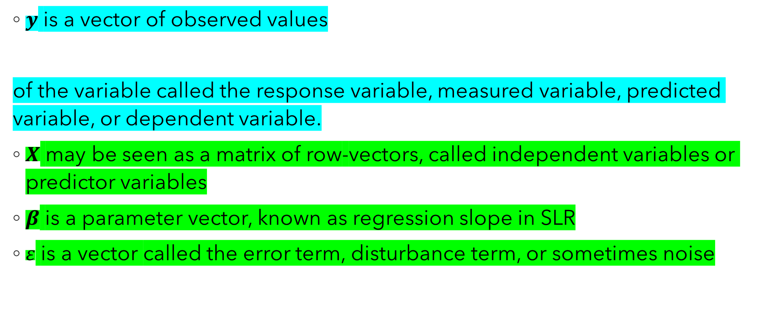
Notation and terminology for LR
$y$ is a vector of observed values
of the variable called the response variable, measured variable, predicted variable, or dependent variable.
$X$ may be seen as a matrix of row-vectors, called independent variables or predictor variables
$β$ is a parameter vector, known as regression slope in SLR
$ε$ is a vector called the error term, disturbance term, or sometimes noise

Slide 37
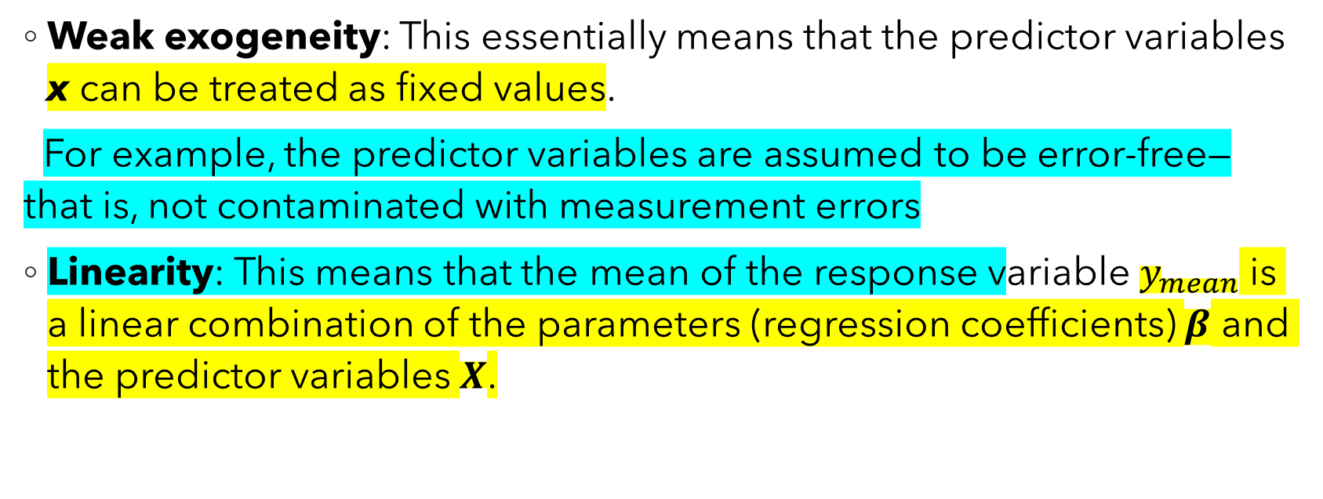
Assumptions of LR
Weak exogeneity: This essentially means that the predictor variables x can be treated as fixed values.
For example, the predictor variables are assumed to be error-free—that is, not contaminated with measurement errors
Linearity: This means that the mean of the response variable $y_{mean}$ is a linear combination of the parameters (regression coefficients) $β$ and the predictor variables $X$.

Slide 38
Assumptions of LR
Constant variance (a.k.a. homoscedasticity): This means that the variance of the errors does not depend on the values of the predictor variables.
Thus the variability of the responses for given fixed values of the predictors is the same regardless of how large or small the responses are.
Independence of errors: This assumes that the errors of the response variables are uncorrelated with each other.

Slide 39
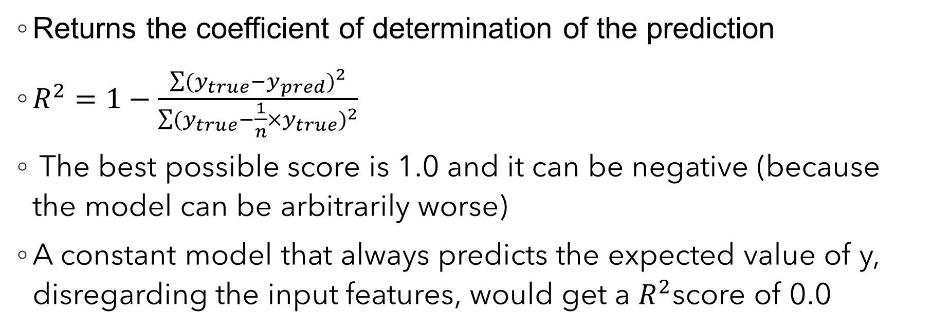
Score of linear regression (score(X, y, sample_weight=None)
Returns the coefficient of determination of the prediction
$R^{2}=1−\frac{\sum{{(y_{true}−y_{pred})}^{2}}}{\sum{{(y_{true}−\frac{1}{n}×y_{true})}^{2}}}$
The best possible score is 1.0 and it can be negative (because the model can be arbitrarily worse)
A constant model that always predicts the expected value of y, disregarding the input features, would get a $R^{2}$score of 0.0

Slide 40
Confusion Matrix
A confusion matrix is a matrix that summarizes the performance of a machine learning model on a set of test data.
Used to measure the performance of classification models, which aim to predict a categorical label for each input instance
The matrix displays the number of true positives (TP), true negatives (TN), false positives (FP), and false negatives (FN) produced by the model on the test data
For binary classification, the matrix will be of a 2X2 table, For multi-class classification, the matrix shape will be equal to the number of classes i.e for n classes it will be nXn

Slide 41
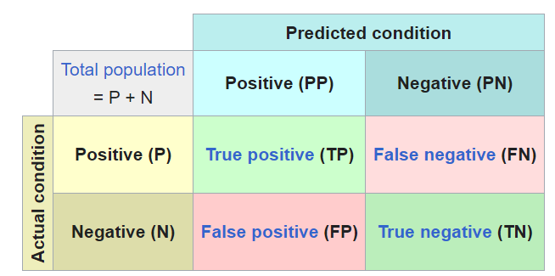

Slide 42
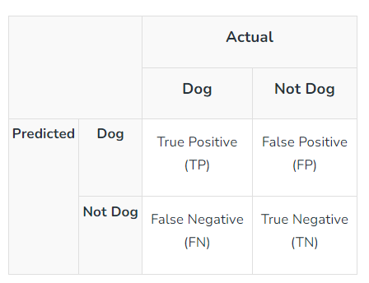
A 2X2 Confusion matrix is shown below for the image recognition having a Dog image or Not Dog image
True Positive (TP): It is the total counts having both predicted and actual values are Dog.
True Negative (TN): It is the total counts having both predicted and actual values are Not Dog.
False Positive (FP): It is the total counts having prediction is Dog while actually Not Dog.
False Negative (FN): It is the total counts having prediction is Not Dog while actually, it is Dog.

Slide 43
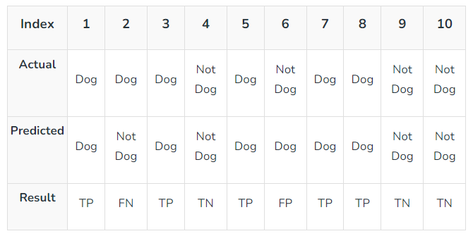

Slide 44
Actual Dog Counts = 6
Actual Not Dog Counts = 4
True Positive Counts = 5
False Positive Counts = 1
True Negative Counts = 3
False Negative Counts = 1

Slide 45
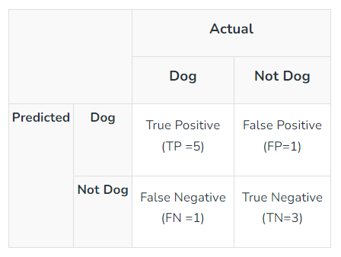
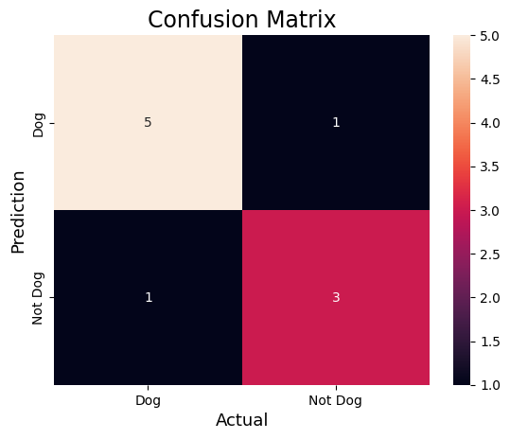
Python Implementation

Slide 46
import numpy as np
from sklearn.metrics import confusion_matrix
import seaborn as sns
import matplotlib.pyplot as plt
actual = np.array(['Dog','Dog','Dog','Not Dog','Dog','Not Dog','Dog','Dog','Not Dog','Not Dog'])
predicted = np.array(['Dog','Not Dog','Dog','Not Dog','Dog','Dog','Dog','Dog','Not Dog','Not Dog’])
cm = confusion_matrix(actual,predicted)
sns.heatmap(cm, annot=True, fmt='g', xticklabels=['Dog','Not Dog'],yticklabels=['Dog','Not Dog'])
plt.ylabel('Prediction',fontsize=13)
plt.xlabel('Actual',fontsize=13)
plt.title('Confusion Matrix',fontsize=17)
plt.show()
[[‘Batman’,’by’,’Nolan’],[‘joker’,’by’,’Joakim’]

Slide 47


Few Statistical Parameters
Accuracy : Accuracy is used to measure the performance of the model. It is the ratio of Total correct instances to the total instances
For the dog image case: Accuracy = (5+3)/(5+3+1+1) = 8/10 = 0.8
Precision: Precision or Positive Predictive Value (PPV) is a measure of how accurate a model’s positive predictions are. It is defined as the ratio of true positive predictions to the total number of positive predictions made by the model
For the above case Precision = 5/(5+1) =5/6 = 0.8333

Slide 48
Few Statistical Parameters
Recall: Recall measures the effectiveness of a classification model in identifying all relevant instances from a dataset.
It is the ratio of the number of true positive (TP) instances to the sum of true positive and false negative (FN) instances.
For the above case: Recall = 5/(5+1) =5/6 = 0.8333

Slide 49
Few Statistical Parameters
F1-Score: F1-score is used to evaluate the overall performance of a classification model. It is the harmonic mean of precision and recall
For the above case
F1-Score: = (2* 0.8333* 0.8333)/( 0.8333+ 0.8333) = 0.8333

Slide 50
Ridge Regression
Ridge regression (or Tikhonov regularization) is a method of estimating the coefficients of multiple-regression models in scenarios where the independent variables are highly correlated.
In statistics, ordinary least squares (OLS) is a type of linear least squares method for choosing the unknown parameters in a linear regression model by the principle of least squares: minimizing the sum of the squares of the differences between the observed dependent variable (values of the variable being observed) in the input dataset and the output of the (linear) function of the independent variable.

Slide 51
Ridge Regression- Why?
The coefficient estimates for Ordinary Least Squares rely on the independence of the features. When features are correlated and the columns of the predictor matrix X have an approximately linear dependence, the least-squares estimate becomes highly sensitive to random errors in the target y, producing a large variance.
Ridge Regression Explained, Step by Step (machinelearningcompass.com)

Slide 52
Ridge regression Example
# importing libraries
from sklearn.linear_model import Ridge
from sklearn.model_selection import train_test_split
from sklearn.datasets import fetch_california_housing
from sklearn.preprocessing import StandardScaler
# loading california housing dataset
boston = fetch_california_housing()
X = boston.data[:, :13]
y = boston.target
print ("Boston dataset keys : \n", boston.keys())
print ("\nBoston data : \n", boston.data)
# scaling the inputs
scaler = StandardScaler()
scaled_X = scaler.fit_transform(X)
# Train Test split will be used for both models
X_train, X_test, y_train, y_test = train_test_split(scaled_X, y,
test_size = 0.3)
# training model with 0.5 alpha value
model = Ridge(alpha = 0.5,tol = 0.001, solver ='auto', random_state = 42)
model.fit(X_train, y_train)
# predicting the y_test
y_pred = model.predict(X_test)
# finding score for our model
score = model.score(X_test, y_test)
print("\n\nModel score : ", score)
ML | Ridge Regressor using sklearn - GeeksforGeeks

Slide 53

Logistic Regression

Slide 54
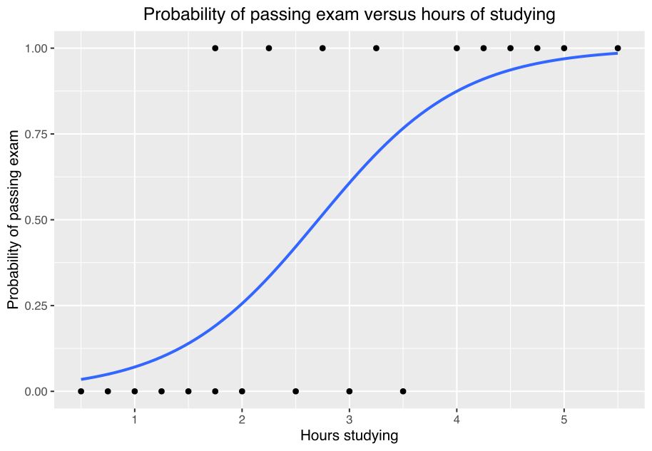

Slide 55
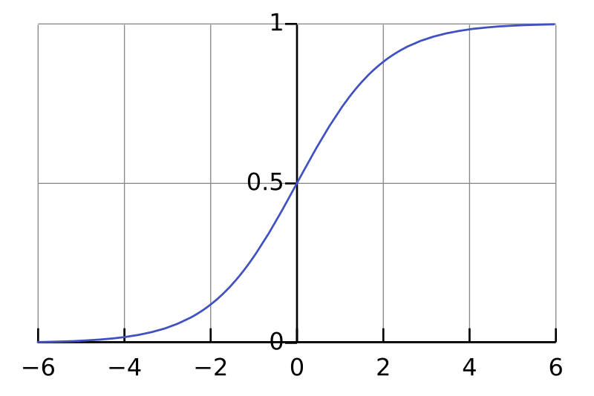

Logistic function or logit function
Standard logistic function $f\left(z\right)=\frac{1}{1+e^{−z}}$
Logistic regression is a binary class classification method

Slide 56
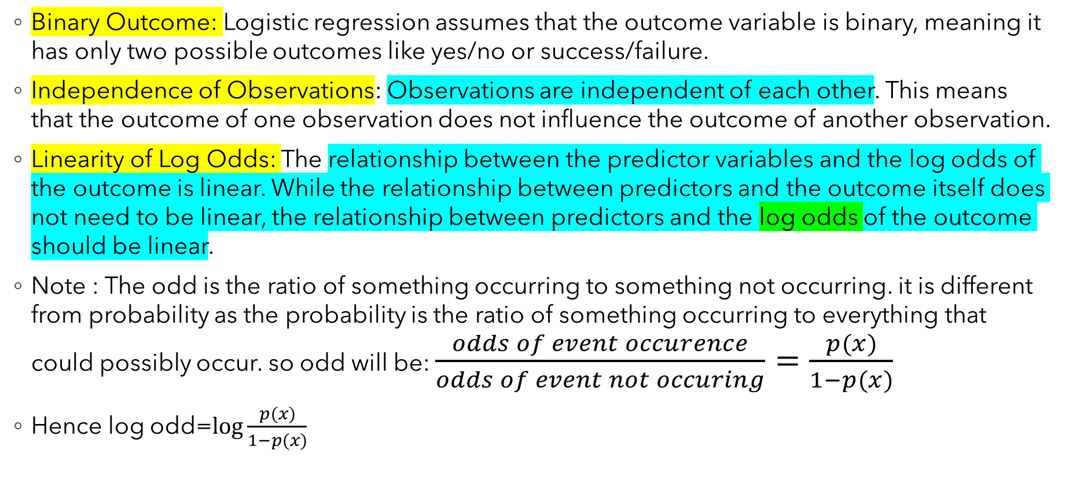
Assumptions of logistic regression
Binary Outcome: Logistic regression assumes that the outcome variable is binary, meaning it has only two possible outcomes like yes/no or success/failure.
Independence of Observations: Observations are independent of each other. This means that the outcome of one observation does not influence the outcome of another observation.
Linearity of Log Odds: The relationship between the predictor variables and the log odds of the outcome is linear. While the relationship between predictors and the outcome itself does not need to be linear, the relationship between predictors and the log odds of the outcome should be linear.
Note : The odd is the ratio of something occurring to something not occurring. it is different from probability as the probability is the ratio of something occurring to everything that could possibly occur. so odd will be: $\frac{odds of event occurence}{odds of event not occuring}=\frac{p(x)}{1−p(x)}$
Hence log odd=$\log{\frac{p(x)}{1−p(x)}}$

Slide 57
Assumptions of logistic regression
Absence of Multicollinearity: Logistic regression assumes that there is no multicollinearity among the predictor variables. Multicollinearity occurs when predictor variables are highly correlated with each other, which can lead to unstable estimates of the coefficients.
Large Sample Size: Logistic regression performs best with a large sample size. While there is no strict rule for the minimum sample size, having a sufficiently large sample size ensures stable parameter estimates and reliable inference.

Slide 58
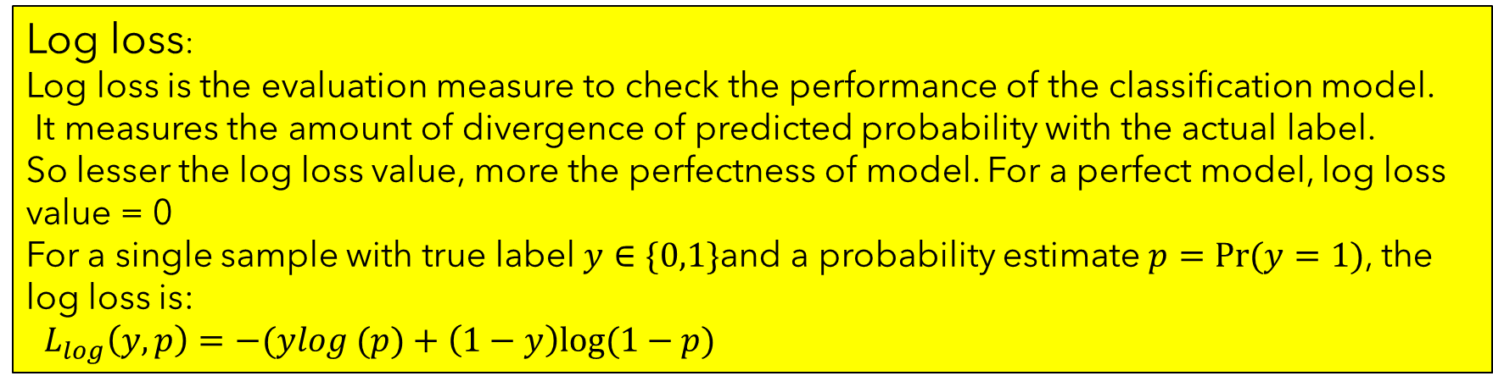
Working Principle of Logistic Regression
Logistic Regression models the likelihood that an instance will belong to a particular class.
It uses a linear equation to combine the input information and the sigmoid function to restrict predictions between 0 and 1.
Different techniques are used to optimize the model’s coefficients to minimize the log loss.
These coefficients produce the resulting decision boundary, which divides instances into two classes.
Log loss:
Log loss is the evaluation measure to check the performance of the classification model.
It measures the amount of divergence of predicted probability with the actual label.
So lesser the log loss value, more the perfectness of model. For a perfect model, log loss value = 0
For a single sample with true label $y∈\{0,1\}$and a probability estimate $p=Pr⁡(y=1)$, the log loss is:
$L_{log}\left(y,p\right)=−(ylog (p)+\left(1−y\right)log⁡(1−p)$

Slide 59
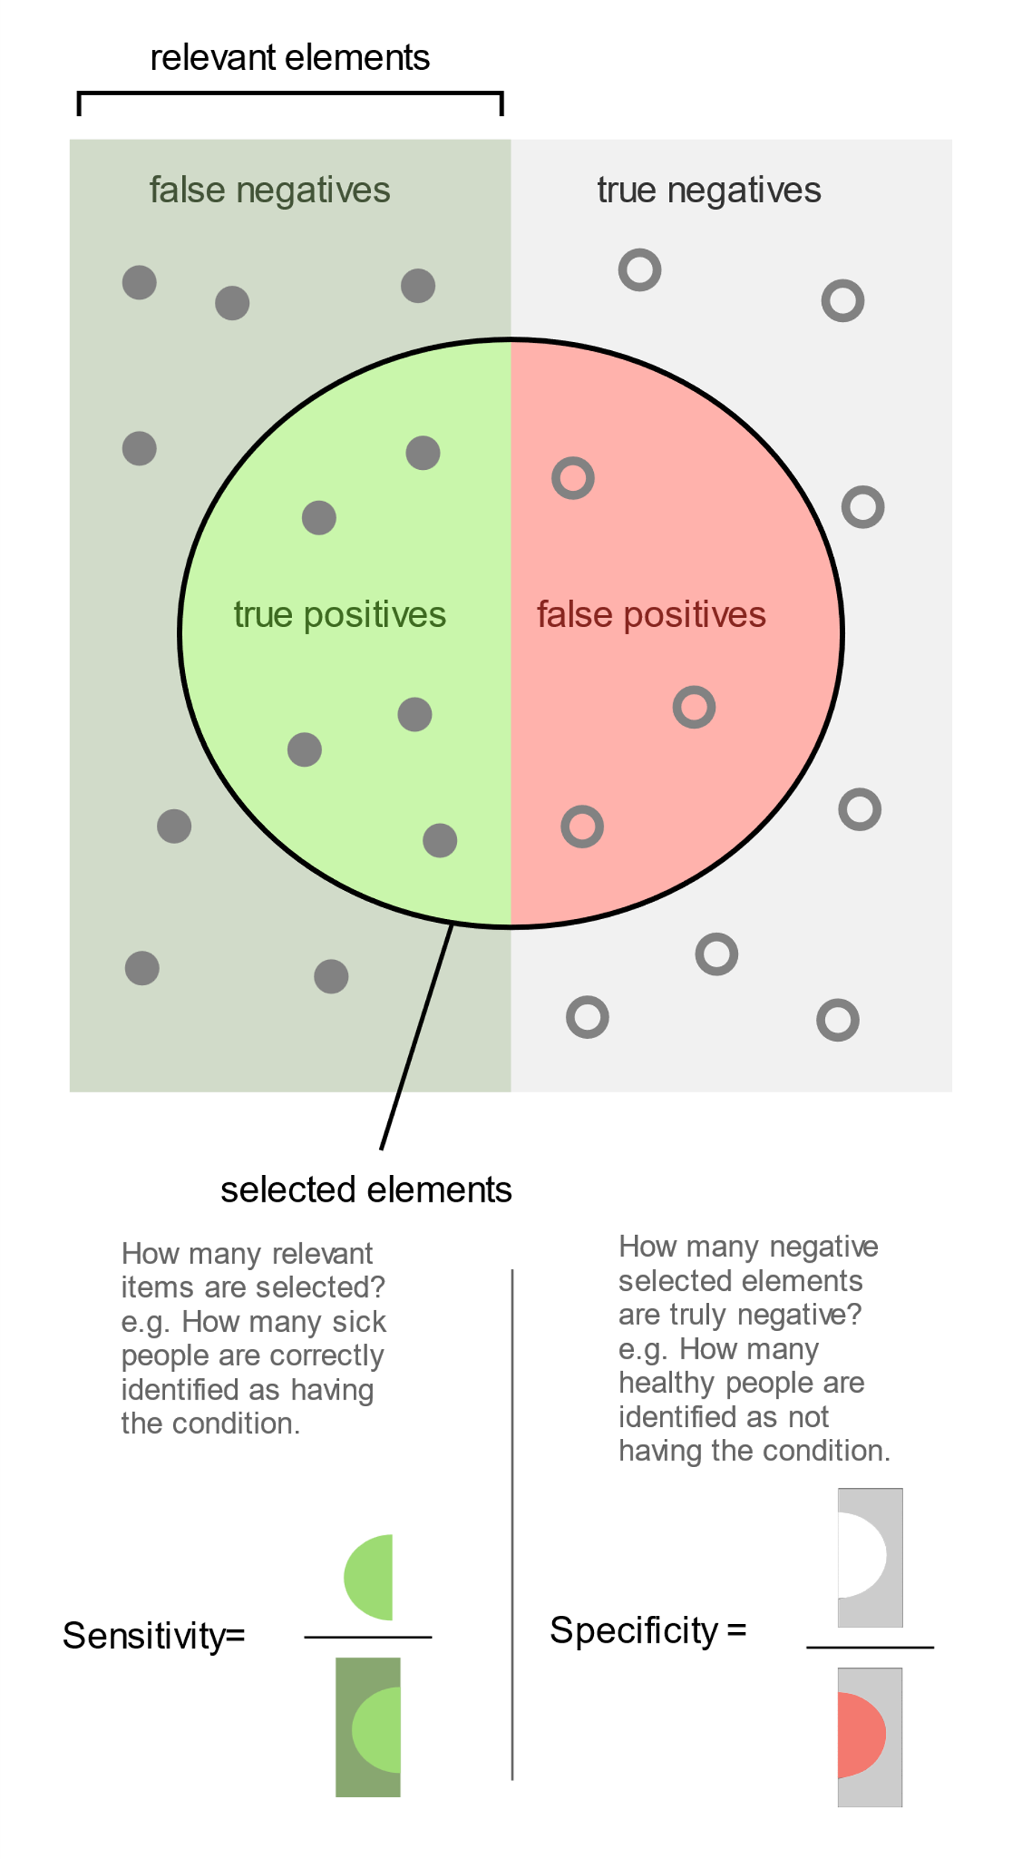
Sensitivity and Specificity
Sensitivity (true positive rate (TPR)) is the probability of a positive test result, conditioned on the individual truly being positive. TPR=TP/P
Specificity (true negative rate) is the probability of a negative test result, conditioned on the individual truly being negative.
False Positive Rate FPR=FP/ (FP+TN), also
FPR=1- Specificity

Slide 60
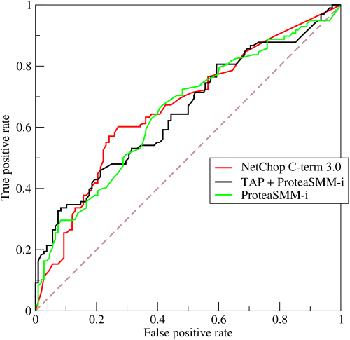
Area Under Receiver Operating Characteristics (ROC)
The ROC curve was first developed by electrical engineers and radar engineers during World War II for detecting enemy objects in battlefields, starting in 1941, which led to its name ("receiver operating characteristic").
The ROC curve is the plot of the true positive rate (TPR) against the false positive rate (FPR)

Slide 61
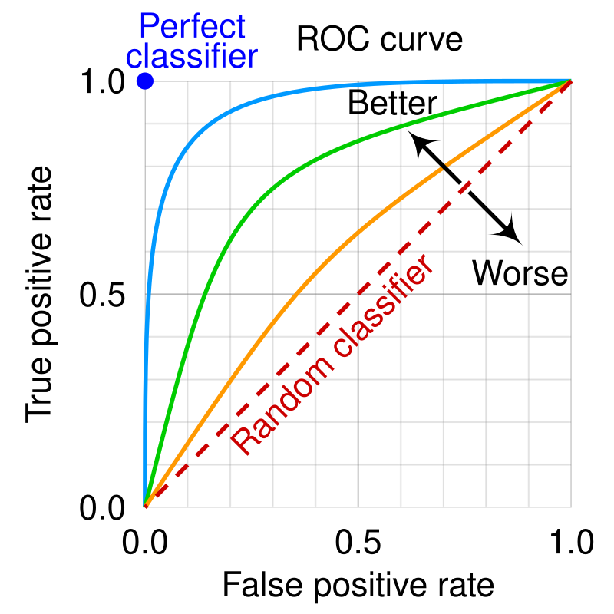
Area Under ROC
A ROC space is defined by FPR and TPR as x and y axes, respectively, which depicts relative trade-offs between true positive (benefits) and false positive (costs).
Each prediction result or instance of a confusion matrix represents one point in the ROC space.
The best possible prediction method would yield a point in the upper left corner or coordinate (0,1) of the ROC space, representing 100% sensitivity (no false negatives) and 100% specificity (no false positives).
The (0,1) point is also called a perfect classification.

Slide 62
Area Under ROC
A random guess would give a point along a diagonal line (the so-called line of no-discrimination) from the bottom left to the top right corners
The diagonal divides the ROC space.
Points above the diagonal represent good classification results (better than random); points below the line represent bad results (worse than random)

Slide 63
Logistic Regression Example
https://colab.research.google.com/drive/1zlb0KBHWDyQpUm-FfmP_l_lL947018c7?usp=sharing
Area under ROC curve AUC ROC Curve in Machine Learning - GeeksforGeeks

